Slide 1







Data Science Capstone
Luke Ganalon
11/15/2023

Slide 2



OUTLINE
Executive Summary
Introduction
Methodology
Results
  Visualization – Charts
  Dashboard
Discussion
  Findings & Implications
Conclusion
Appendix

Slide 3

EXECUTIVE SUMMARY
Summary of methodologies
  SpaceX Data Collection using SpaceX API
  SpaceX Data Collection with Web Scraping
  SpaceX Data Wrangling
  SpaceX Exploratory Data Analysis using SQL
  SpaceX EDA DataViz
  SpaceX Launch Sites Analysis
  SpaceX Machine Learning Landing Prediction
Summary of all results
  EDA Results
  Interactive Visual Analytics and Dashboards
  Predictive Analysis

Slide 4

INTRODUCTION
Project background
  SpaceX Falcon 9 rocket launches save money due to the reuse of their first stage.
Problem to solve
  Predict if the Falcon 9 first stage will land successfully

Slide 5

METHODOLOGY
Data Collection methodology
  Describes how data was collected
Data Wrangling
  Processing the data
EDA
Folium and Plotly Dash
Predictive Analysis
  Building, tuning, and evaluating models

Slide 6
Data Collection
Collecting Data on the SpaceX Falcon9
Data was collected using the SpaceX API. A series of helper functions were defined to extract information using identification numbers. Then the data was requested from the SpaceX API url.
The SpaceX launch data was requested and parsed using the GET request and then decoded as a JSON file to be converted into a Pandas data frame.
Web scraping was also performed to collect the historical data of Falcon9 launches from the given wikipedia website. Using BeautifulSoup and request libraries, the Falcon9 HTML table records were extracted. Finally, the table was parsed and converted into a Pandas data frame.
Here is the relative Github URLs: https://github.com/lganalon/IBM-Data-Science-Capstone/blob/main/jupyter-labs-spacex-data-collection-api.ipynb & https://github.com/lganalon/IBM-Data-Science-Capstone/blob/main/jupyter-labs-webscraping.ipynb

Slide 7
Data Wrangling
After the creation of the Pandas DF, the data was filtered to only keep the launches of the Falcon9. The missing values were then dealt with.
Exploratory Data Analysis (EDA) was then performed to find some patterns in the data.
Here is the relative Github URL: https://github.com/lganalon/IBM-Data-Science-Capstone/blob/main/labs-jupyter-spacex-Data%20wrangling.ipynb

Slide 8
EDA with Data Visualization
After the creation of the Pandas DF, the data was filtered to only keep the launches of the Falcon9. The missing values were then dealt with.
Exploratory Data Analysis (EDA) was then performed to find some patterns in the data.
Here is the relative Github URL: https://github.com/lganalon/IBM-Data-Science-Capstone/blob/main/labs-jupyter-spacex-Data%20wrangling.ipynb

Slide 9
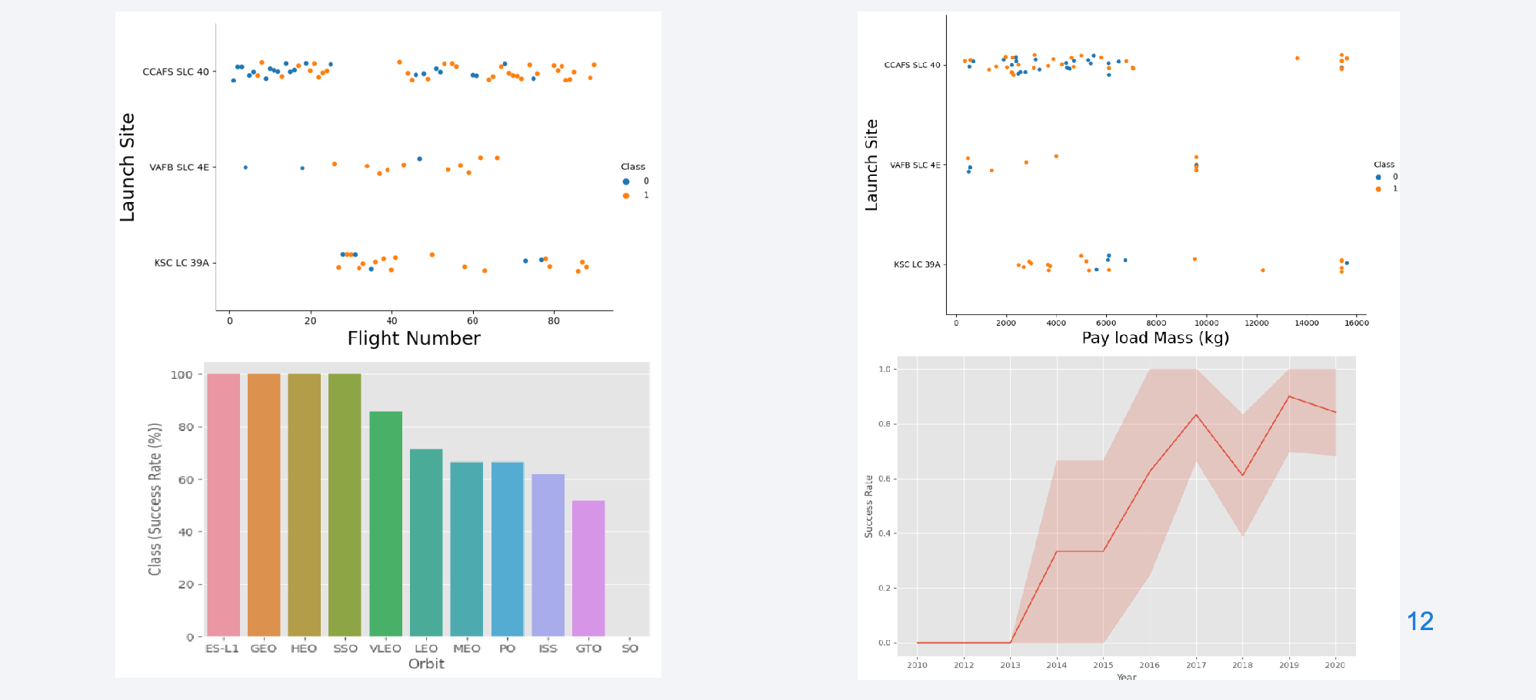
EDA with Data Visualization

Slide 10
EDA with SQL
SQL queries:
  Display the names of the unique launch sites
  Display 5 records where launch sites began
  Display the total payload mass carried by boosters
  Display average payload mass carried by booster version F9 v1.1
  List the date when the first successful landing outcome in the ground pad was achieved
  List the names of boosters which have success in drone ship and have a payload between 4000 and 6000 kg
  List the total number of successful and failed mission outcomes
  Github URL: https://github.com/lganalon/IBM-Data-Science-Capstone/blob/main/jupyter-labs-eda-sql-coursera_sqllite.ipynb

Slide 11
Building an Interactive Map w/ Folium
Built a folium map to mark the launch sites
Added map objects such as markers, circles, and lines to mark the success or failure of launches for each site
Created a launch set outcomes (failure=0 and success=1)
Github URL: https://github.com/lganalon/IBM-Data-Science-Capstone/blob/main/lab_jupyter_launch_site_location.jupyterlite.ipynb

Slide 12
Build a Dashboard w/ Plotly Dash
Built an interactive dashboard application with Plotly Dash
  Add launch sites drop-down input component
  Add callback functions to render success pie-chart and render the success-payload scatter plot
  Add a range slider to Select Payload kilograms
Github URL: https://github.com/lganalon/IBM-Data-Science-Capstone/blob/main/spacex_dash_app.py

Slide 13
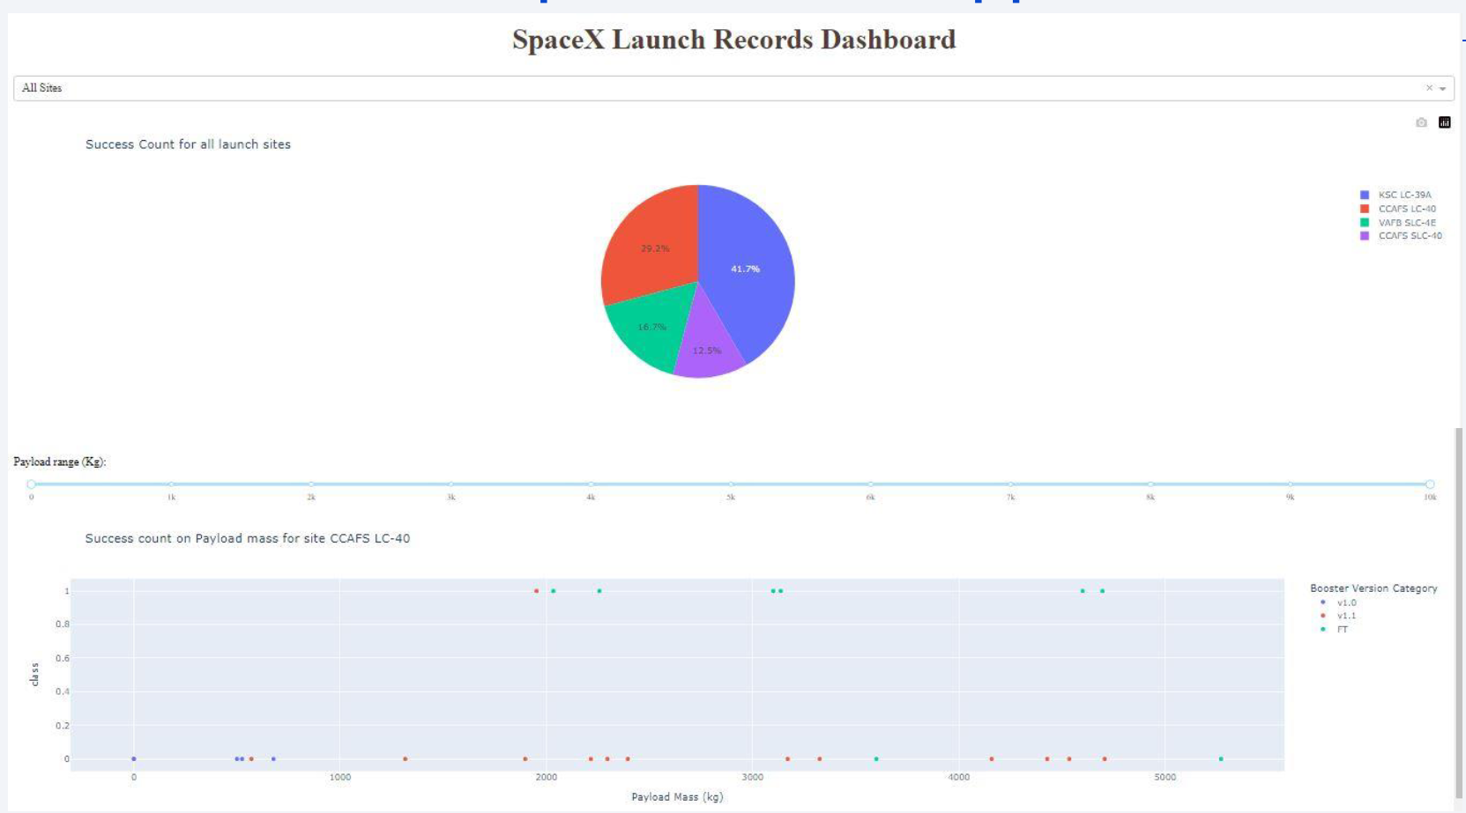
SpaceX Dash App

Slide 14
Predictive Analysis (Classification)
Summary of the classification model
First, EDA was performed and training labels were determined by:
  Creating a NumPy array from the column Class, by applying the method of to_numpy() then assign it to the variable 'Y' as the outcome variable
  Standardize the feature dataset by transforming it using the StandardScaler() function from Sklearn
  Split the data into training and test sets and apply parameters

Slide 15
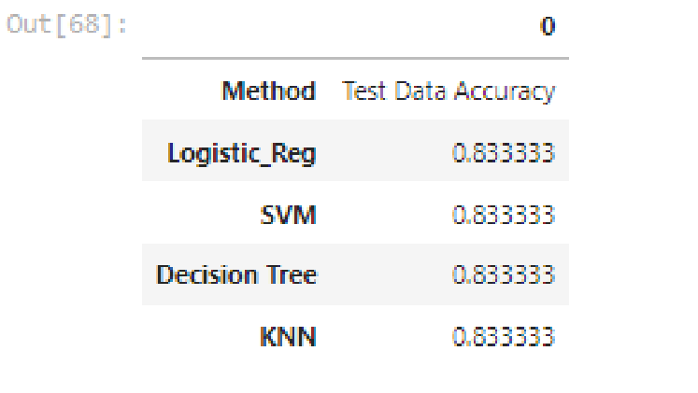
Predictive Analysis (Classification) cont.
Run various models to see which performs best on the test set
  SVM
  Classification Tree
  K-Nearest-Neighbors
  Logistic Regression
  Github URL: https://github.com/lganalon/IBM-Data-Science-Capstone/blob/main/SpaceX_Machine_Learning_Prediction_Part_5.jupyterlite.ipynb

Slide 16

CONCLUSION
Model Performance: The models performed similarly on the test set with the decision tree model slightly outperforming
Equator: Most of the launch sites are near the equator for an additional natural boost - due to the rotational speed of earth - which helps save the cost of putting in extra fuel and boosters
Coast: All the launch sites are close to the coast
Launch Success: Increases over time
• KSC LC-39A: Has the highest success rate among launch sites. Has a 100% success rate for launches less than 5,500 kg
• Orbits: ES-L1, GEO, HEO, and SSO have a 100% success rate
• Payload Mass: Across all launch sites, the higher the payload mass (kg), the higher the success rate

